Slide 1
Geoclient API
Why bother?

Slide 2
Easy access to Geosupport

Slide 3
Goodnight!
We love you, New York City!
Come again soon!

Slide 4
What is Geosupport?

Slide 5
Geosupport is...
The City of New York’s
Official
“Geocoder of Record”

Slide 6
Geosupport is...
NYC’s geocoder since the early 1980’s!
(before Brooklyn®)

Slide 7
Geosupport - “Lingua Franca”
Real Estate Developer
Contractor
Property Owner
Borough President’s Office
DOB
DOF
911
Geosupport
DCP
A4
NYPD
FDNY
DEP
DOITT
CSCL

Slide 8
Geosupport - Data Validation & Standardization
Public
SIG
SIG
SIG
Agency
311
Agency
Agency
Agency
Geosupport

Slide 9
Geosupport - Data Validation & Standardization
Geosupport
SIG
Agency
311 Analytics
Agency
Agency
SIG
City Fat Cats

Slide 10
Geosupport is used by agencies like
311, 911, ACJ, ACS, AJC, BCPA, BIC, BOC, BOE, BPL, BSA, Bronx DA, Brooklyn DA, CAU, CB, CCHR, CCPC, CCRB, CECM, CEO, CFB, COIB, COMP, CSC, CUNY, DCA, DCAS, DCLA, DCP, DDC, DEP, DFTA, DHS, DOB, DOC, DOE, DOF, DOHMH, DOI, DOITT, DOP, DOT, DPR, DSNY, DYCD, EDC, FDNY, GNYC, HPD, HRA, HRO, IA, LAW, LOFT, LPC, MCCM, MOA, MOCS, MODA, MOIA, MOIGA, MOME, MOPD, MOSE, MOVA, Manhattan DA, Mayor's Office of Criminal Justice, NBAT, NYCERS, NYCGO, NYCHA, NYCOA, NYPD, NYPL, NYW, NYWB, New York City Council, OATH, OCDV, OCME, OEC, OEM, OER, OLR, OLTPS, OM, OMB, OPA, OPS, PPB, PPF, SBS, SNP, Staten Island DA, TAT, TC, TLC, WIB, ...

Slide 11
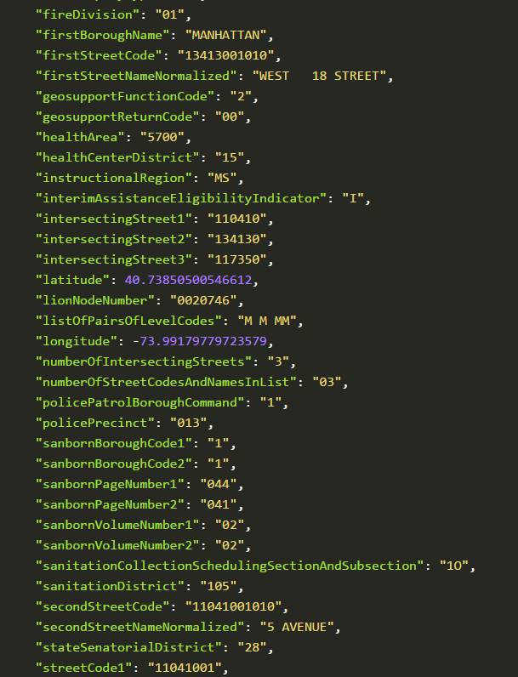
Data?
Geosupport has lots of data
(If you’re into that kind of thing)

Slide 12
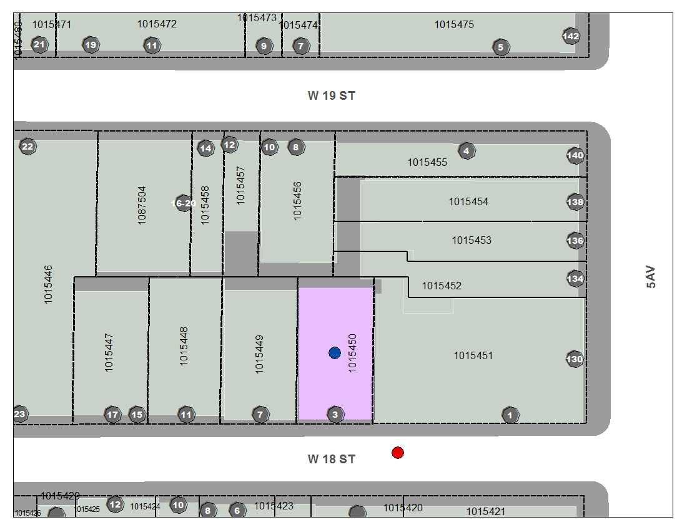
3 West 18th Street
Interpolated address
Property (Parcel)
CSCL Address Point

Slide 13
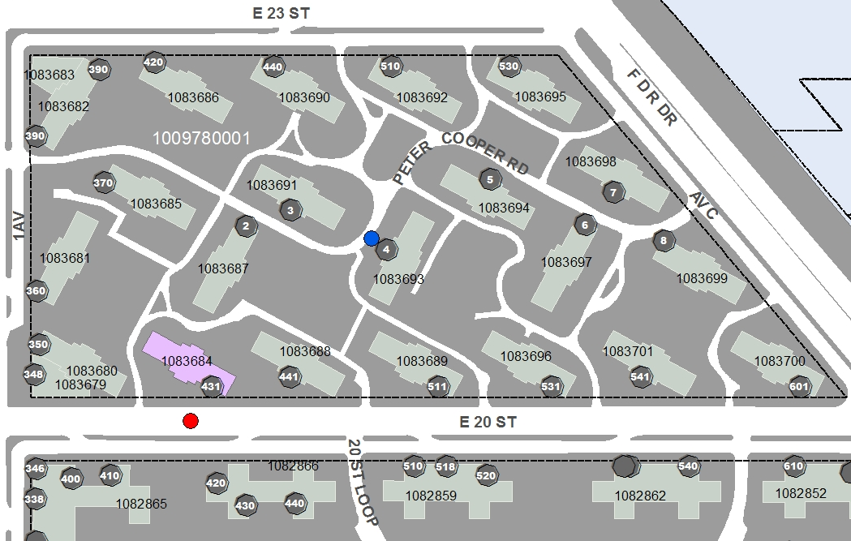

Slide 14
Geosupport is...
A magic, get-out-of-jail-card-style, foreign-key
BIN# 1015450
948 Jamaica Ave, BK
BBL: 100670001
Community District 5

Slide 15
Does NYC need it’s own geocoder?

Slide 16
Intersections
What’s not to love?

Slide 17
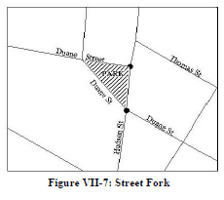
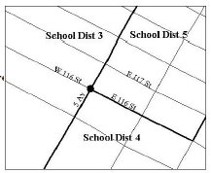
Intersections
Although, they can be annoying...

Slide 18
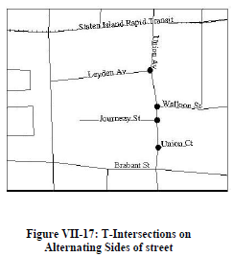
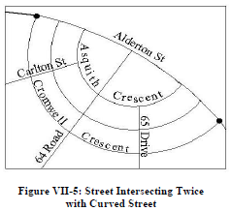
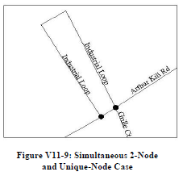
Intersections
Now you’re just being mean.

Slide 19
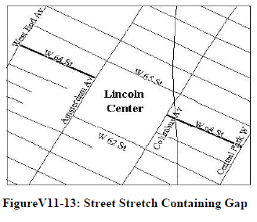
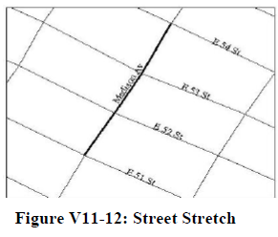
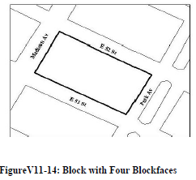
Blockface
Et tu, Blockface?

Slide 20
Street Name | B10SC = | BORO+ | 5SC + | LGC + | SNC
A C POWELL BOULEVARD | 11061001010 | 1 | 10610 | 01 | 010
AC POWELL BOULEVARD | 11061001020 | 1 | 10610 | 01 | 020
ADAM C POWELL BOULEVARD | 11061001030 | 1 | 10610 | 01 | 030
ADAM POWELL BOULEVARD | 11061001040 | 1 | 10610 | 01 | 040
ADAM POWELL JR BOULEVARD | 11061001050 | 1 | 10610 | 01 | 050
ACP BOULEVARD | 11061001060 | 1 | 10610 | 01 | 060
A C P BOULEVARD | 11061001070 | 1 | 10610 | 01 | 070
POWELL BOULEVARD | 11061001080 | 1 | 10610 | 01 | 080
ADAM CLAYTON POWELL BOULEVARD | 11061001090 | 1 | 10610 | 01 | 090
ADAM CLAYTON POWELL JR BOULEVARD | 11061001100 | 1 | 10610 | 01 | 100
FASHION AVENUE | 11061002010 | 1 | 10610 | 02 | 010
SAINT VINCENTS SQUARE | 11061003010 | 1 | 10610 | 03 | 010
ST VINCENTS SQUARE | 11061003020 | 1 | 10610 | 03 | 020
7 AVENUE | 11061004010 | 1 | 10610 | 04 | 010
SEVENTH AVENUE | 11061004020 | 1 | 10610 | 04 | 020

Slide 21
House Numbers
519 Front East 12th Street, Manhattan
625 Rear Smith Street, Brooklyn
120 1/2 First Avenue, Manhattan
240-55 1/3 Depew Avenue, Queens
469 1/4 Father Capodanno Boulevard, Staten Island
470 A West 43rd Street, Manhattan
171C Auburn Avenue, Staten Island
20-29 Garage 120th Street, Queens

Slide 22
Queens House Numbers

Slide 23
What is Geoclient?

Slide 24
Geoclient is...just this part?!
Geosupport
“But sir, it’s only a wafer-thin mint!”

Slide 25
Uh...yeah.

Slide 26
Not using Geoclient

Slide 27
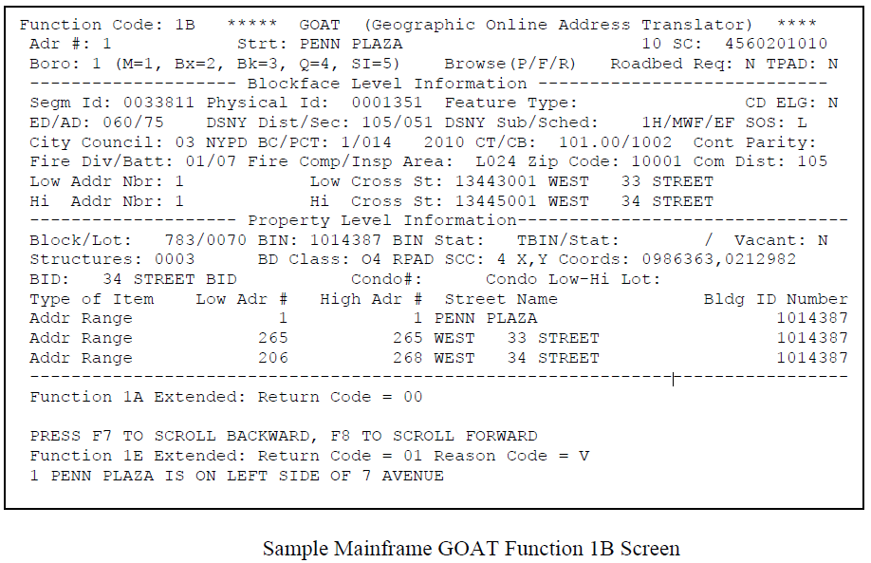

Slide 28
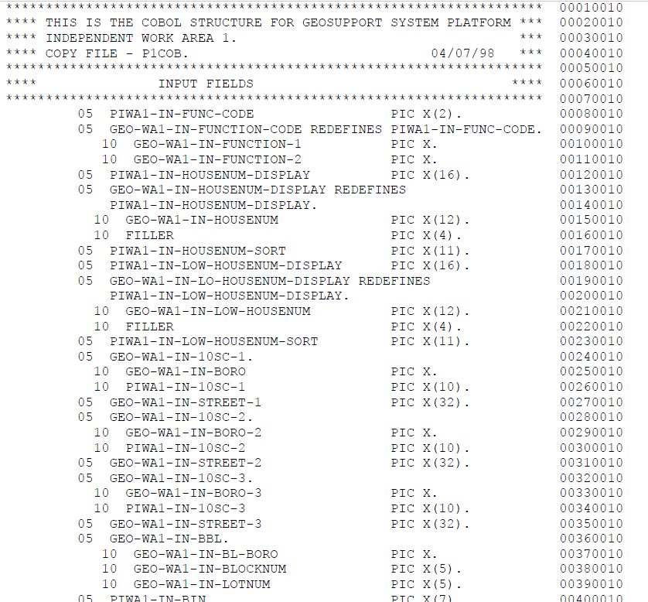
COBOL API

Slide 29
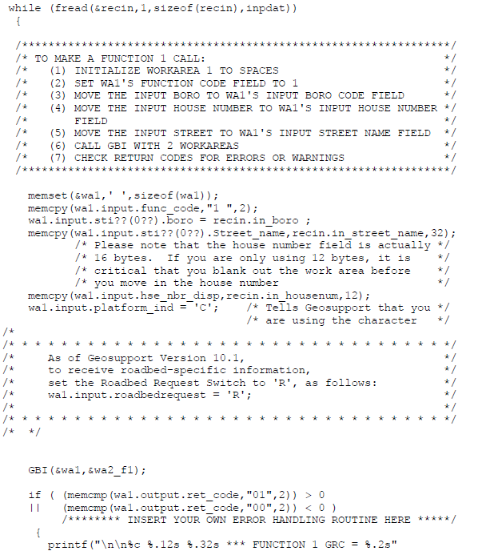
C API

Slide 30
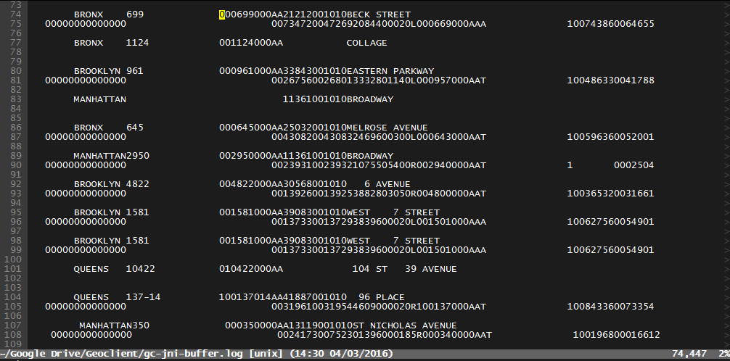
Geosupport - Character Only Work Areas

Slide 31

Geosupport - Character Only Work Areas
DEAL WITH IT

Slide 32
To the Interwebs!

Slide 33
City of New York
Geoclient
DoITT / Citywide GIS
Colin Reilly (Director) - creilly@doitt.nyc.gov
Matthew Lipper (Me) - mlipper@doitt.nyc.gov
Developers - gis-development@doitt.nyc.gov
GitHub
https://github.com/CityOfNewYork/geoclient
NYC Developer Portal https://developer.cityofnewyork.us/api/geoclient-api
Geosupport
Department of City Planning
Rudy Lopez - rlopez@planning.nyc.gov
GS questions - gss_feedback@planning.nyc.gov
GOAT
http://nyc.gov/goat
Geosupport
http://www1.nyc.gov/site/planning/data-maps/open-data.page#geocoding_application

